Slide 1
US Ignite – Fort Carson
Fall 2022 Final Presentation
Yachen Guo, Adithi Reddy Kallem, Satvik Kumar,
Ananya Raghupathy, Jonathan Wang, Chengyuan Zhang

Slide 2
Agenda
Introductions
Project Overview
Data Handling
Model
Recommendations & Future Work
Q&A

Slide 3
Introductions

Slide 4






Team
Ananya Raghupathy MISM BIDA
Project Manager
Jonathan Wang MISM General
Finance Lead
Yachen Guo MISM BIDA
Adithi Reddy Kallem MISM BIDA
Chengyuan (William) Zhang MISM General
Satvik Kumar MISM General
Notes:
Ananya

Slide 5


Team
Neelam Dwivedi
Adjunct Professor, Heinz College
Palak Agarwal
Geospatial Data Scientist, US Ignite
Notes:
Ananya

Slide 6



Client and Stakeholders
Notes:
Our client for this project is US Ignite.
a non-profit research organization
accelerating the smart cities movement
For over ten years, US Ignite has worked closely with many federal agencies, more specifically with Fort Carson, and by extension the City of Colorado Springs.
So The Fort Carson Traffic and Weather Prediction Platform analyzes traffic and weather data in real time to optimize responses to inclement weather and traffic incidents at Fort Carson in Colorado Springs, Colorado.
Direct Stakeholder would be the Garrison Commander at Fort Carson who will utilize our deliverables, which we will get into later.

Slide 7
Project Background

Slide 8
Safety Statistics
In 2020, El Paso County led the state of Colorado in the most fatal traffic accidents and speeding charges.
Colorado Springs Police July 7, 2022 report shows 25 traffic deaths. This is about the same as 2021’s by the same date.
If this trend continues, “2022 could be on the same track as 2020 when a record-breaking 51 traffic deaths were recorded in the city.”
Notes:
https://www.kktv.com/2022/07/07/more-people-dying-colorado-springs-roads-2022-track-with-record-year-most-traffic-deaths/
So to understand a little bit more about the necessity for such a project, we can see from this slide.

Slide 9

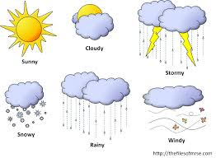
Our Objective
How can we implement an informed model to create a road-safety metric to help guide the decision of: closing the base early, delaying the opening of the base, or closing the base for the day?
Notes:
As mentioned before, inclement weather and frequent commuters are a safety hazard which can affect base productivity and quite literally; people’s lives.
So, the problem we are trying to solve ( at least for military personnel) :

Slide 10
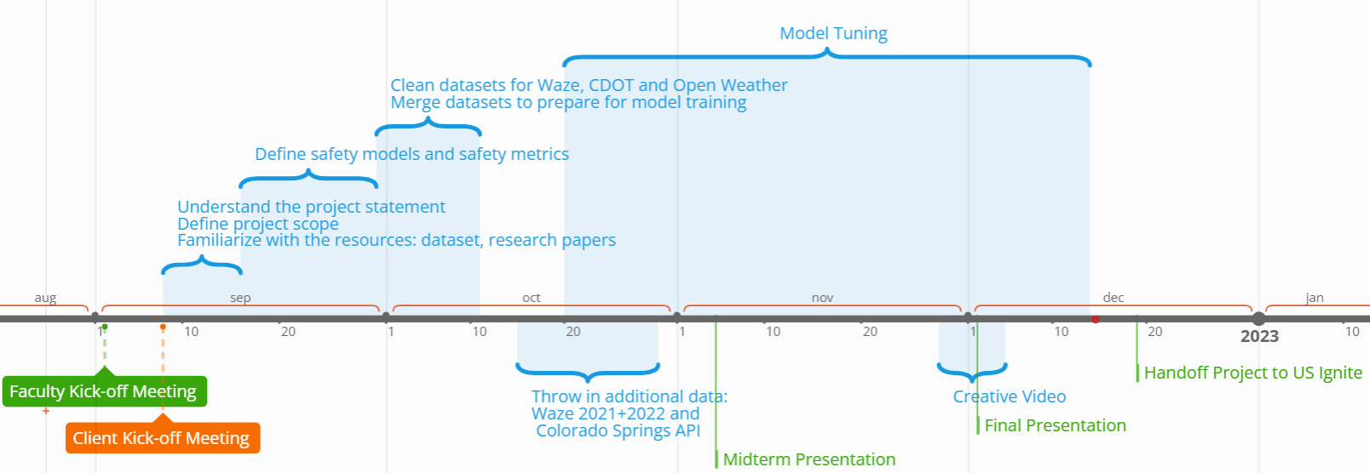
Timeline

Slide 11
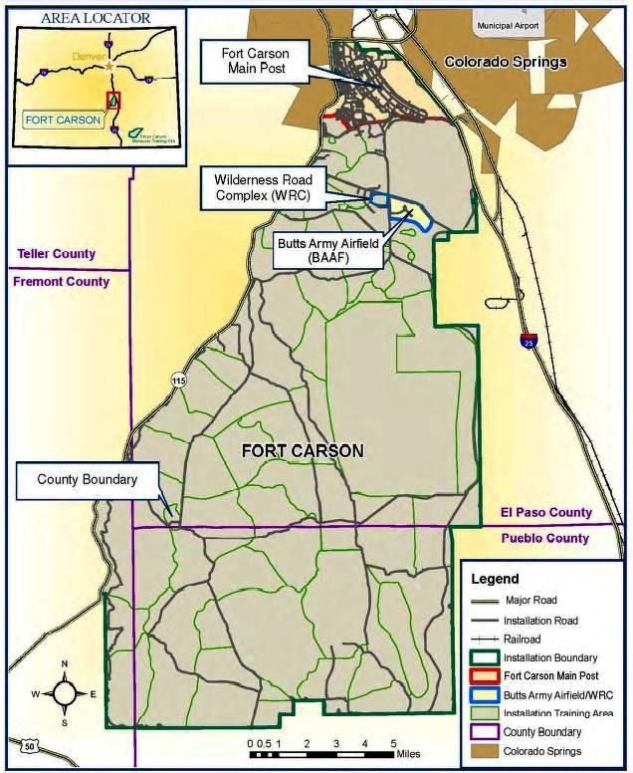
Fort Carson Background
3rd Largest Employer in Colorado
Over 30,000 commuters daily
7 main gates
Notes:
FCCO is the 16th largest city by population and the largest city by square miles in Colorado (FCCO & PCMS are 582 square miles. 2nd is Colorado Springs at 194 square miles)
Fort Carson plays a major role in the regional and state economy
3rd largest employer in Colorado after the State of Colorado(39K) and Denver International Airport (35K) FCCO has 33.5K
Fort Carson provides a $2.4B economic impact annually compared to $25.7B for manufacturing, $2.1B for agriculture / fishing / hunting, $22B for tourism and $14.2B for mining (2019 data)
With over 30,000 military service members and staff commuting on and off post daily through 7 main entry gates, Fort Carson is prone to struggling with traffic congestion management at entryways and surrounding city roadways.
Located along 3 of the regions strategic corridors, including I-25, which is considered the backbone of commercial freight movement for the state of Colorado and the CanAm Corridor stretching from Mexico to Canada.

Slide 12
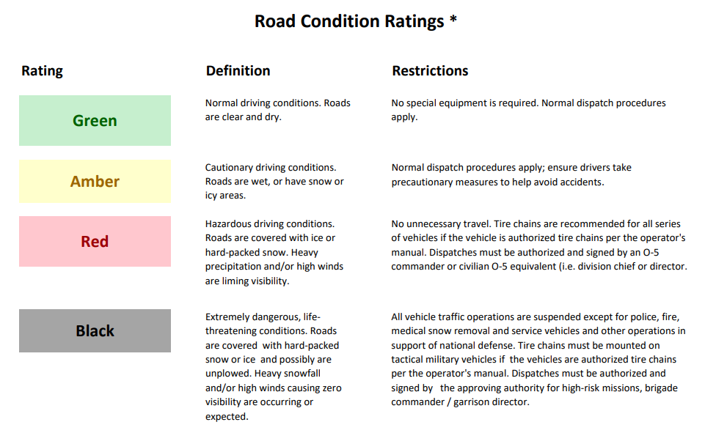
Client Deliverables
A script that can define a BRAG Safety Metric for each “nearby” road:
Output: Excel file + Dashboard
Notes:
Military term for
Nearby roads means roads we pick to be the most relevant. Use CMU as example. CMU would care more about Forbes and Fifth, and not a neighborhood street in Cranberry or even squirrel hill. However,

Slide 13
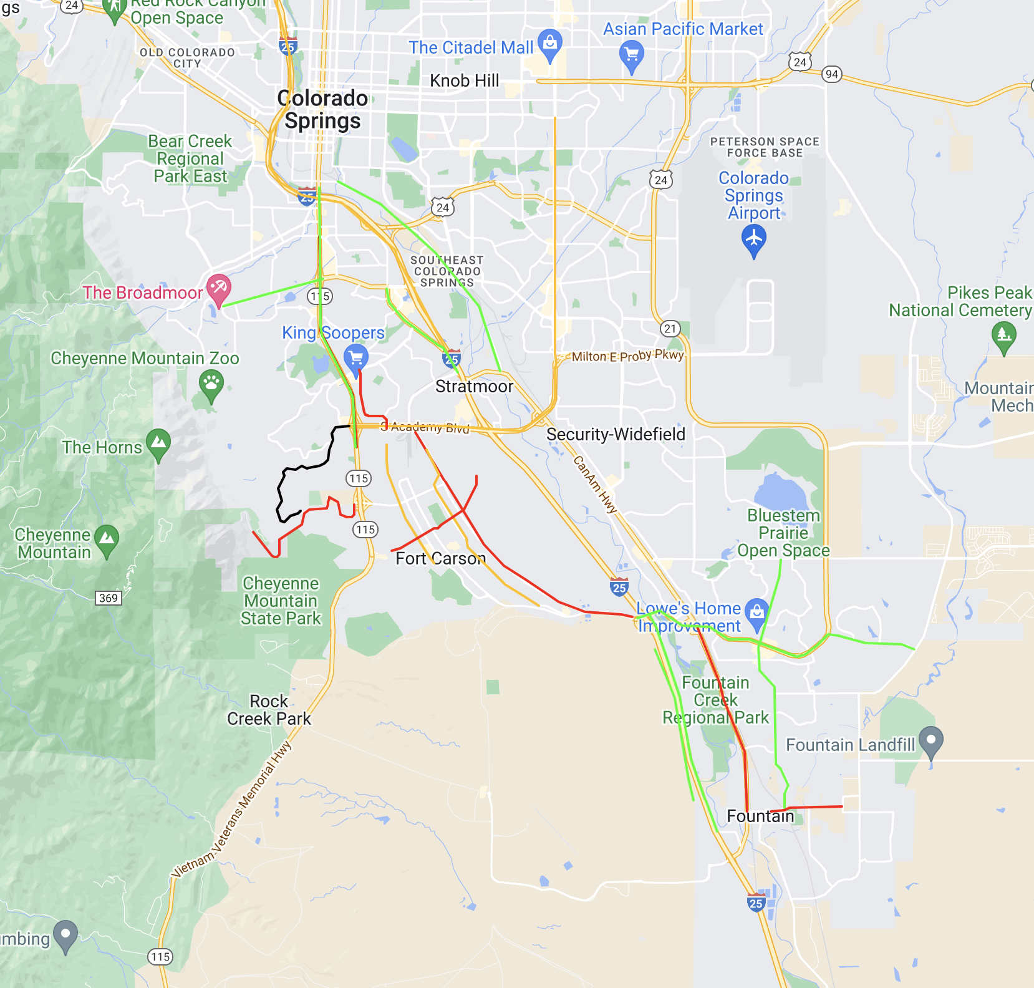
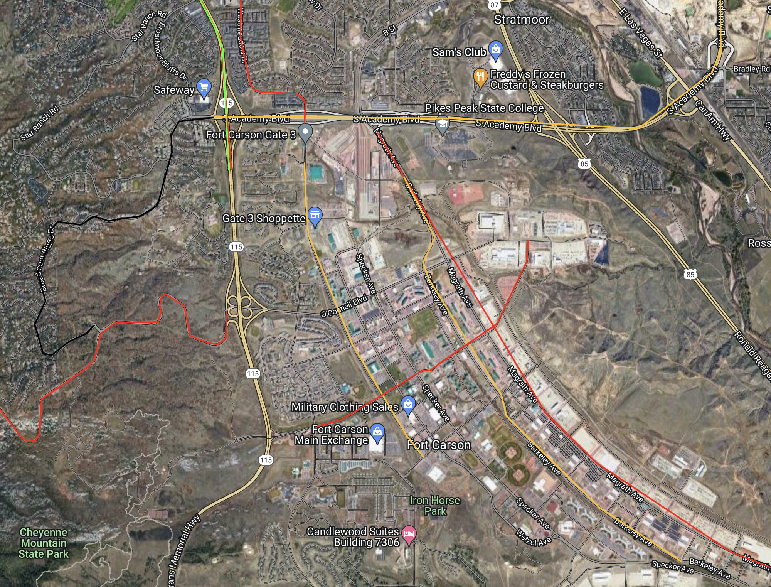
Roads
Notes:
Here we can see a sneak peek of our dashboard, and these are the roads we have chosen to be a part of our model.

Slide 14
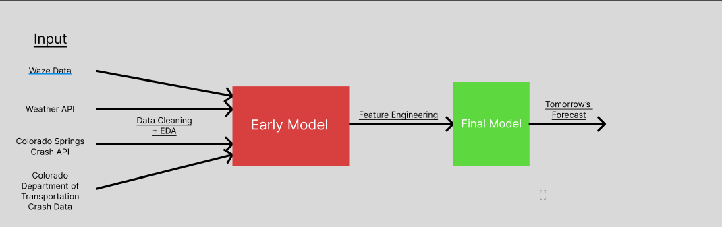
Model Development

Slide 15
Early Model Development and Output (Pre-Midterm)
Decision Tree algorithm for better readability
Choosing f1_score as the metric
Test metrics: 0.98
Size of the dataset

Slide 16
Workarounds
Re-evaluate model to investigate the suspiciously high f1-score
Integrate additional years and streets into the data + model.
Integrated 2020-2022 data along with the existing 2019 data
Increasing data points.
Split data on hourly basis instead of day-to-day basis
Create safety metric ranges based on crash percentage.
BRAG Predefined Ranges
Notes:
Ananya

Slide 17
Data

Slide 18




Tech Stack

Slide 19
Data Sources
 | Open Weather | Waze for Cities | Google Maps (Distance Matrix) | Tom Tom | Crash Data API
Information | Weather Description Temperature Wind speed Time | Jam level Location Time Irregularities Incidents Descriptions Weather Hazard/ Hazard Trends | Departure times Arrival times Location Distance | Time Location Incident Description Relative flow | Location Accident DateTime Accident cause Contributing factors Injury/death
Historic vs. Real-time | All | All (can only access historical) | All | Real time only | Historic only
Notes:
Chengyuan

Slide 20
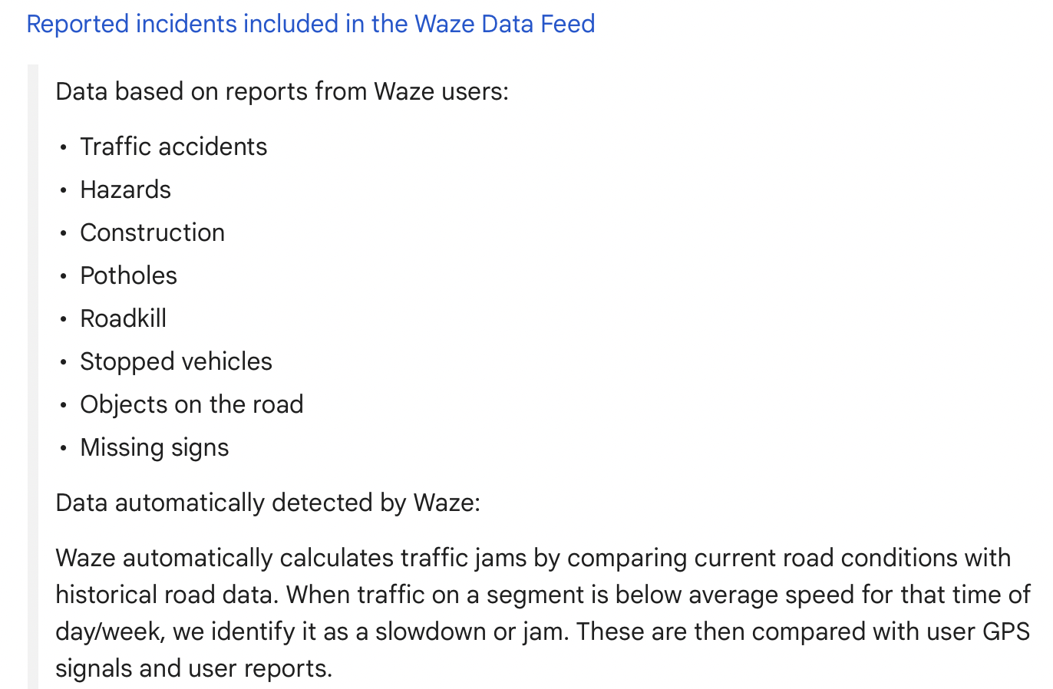

Waze Data

Slide 21
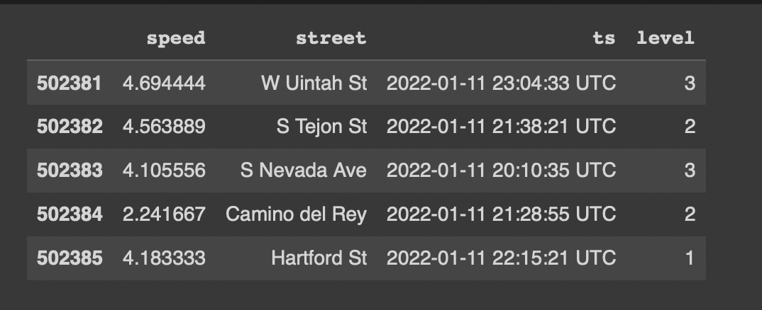
Data Cleaning: Waze
Determine relevant columns
Currently using 2019, 2020 (post-June), 2021, 2022 data

Slide 22
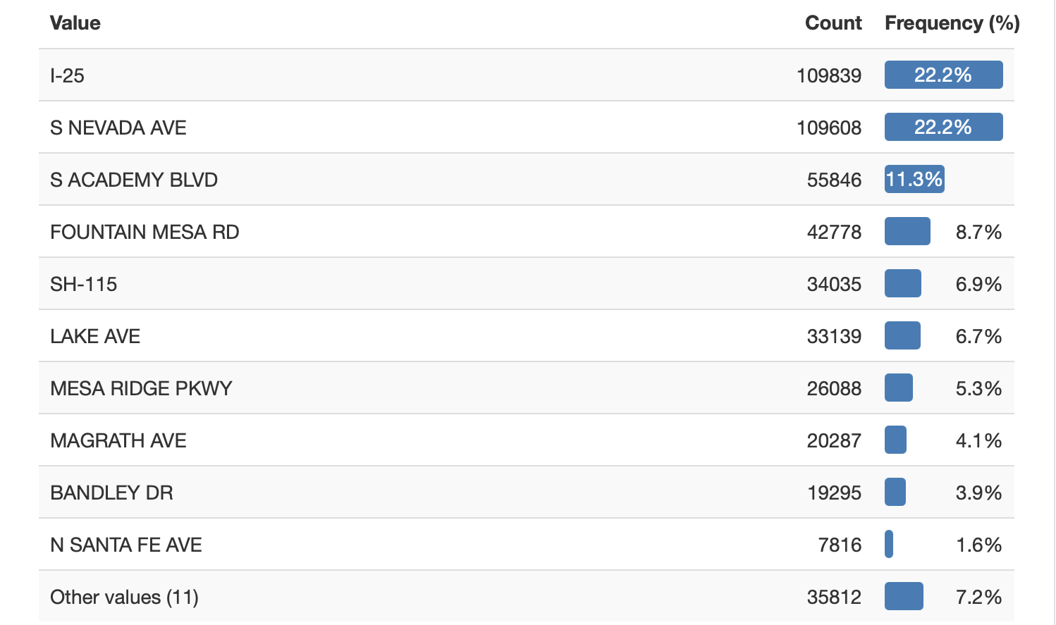
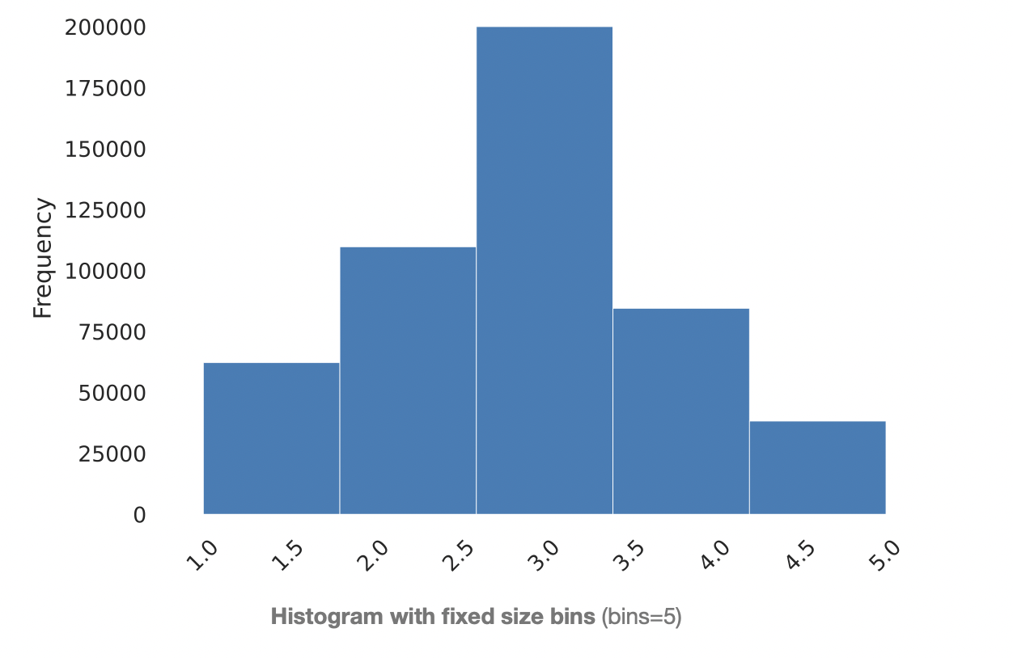
EDA: Waze Data
Jam Level Distribution
Roads chosen

Slide 23
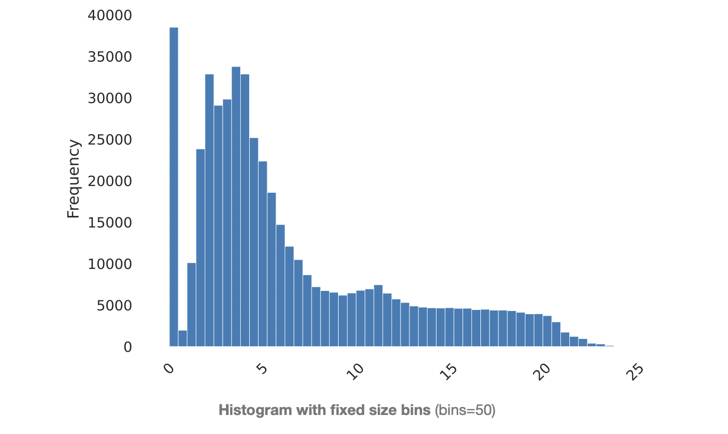
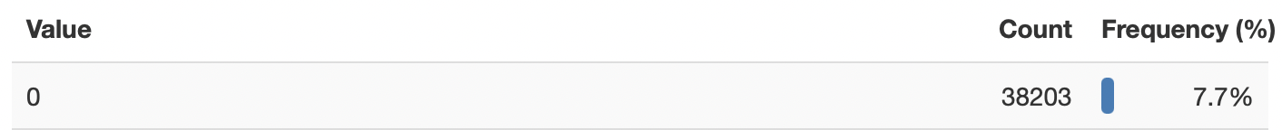
Challenges: Waze Data
The “speed” variable in the Waze dataset had a lot of values that were ‘0’.
This was fixed using the median for every street in every hour.

Slide 24

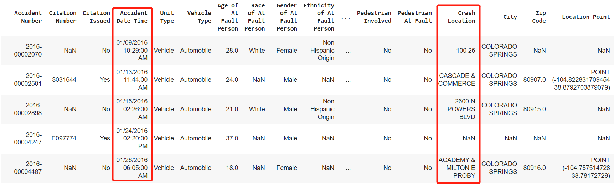
Dataset: Colorado Springs Crash API
Changed from CDOT dataset to Colorado Springs API dataset to increase the overlap years with waze data.

Slide 25
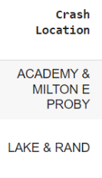
Data Cleaning: Colorado Springs Crash API
Data cleaning methods
Clean timestamp and round it to the nearest hour
Split the crash location if have multiple roads
Keep this record if any one of the roads contains in our target roads list
Use a dictionary to map the crash road name with the target road list
Regular expression

Slide 26

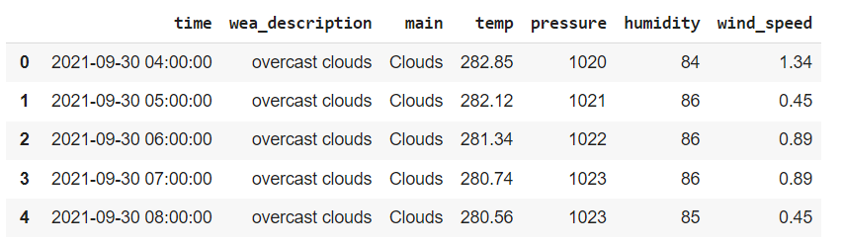
Data Cleaning: OpenWeatherAPI
Determine relevant columns such as:
Temperature, pressure, humidity
Wind speed, wind degree
Weather description
Concatenate date and time to make it standardized
Feature engineering, one hot encoding for weather description
Notes:
+sample

Slide 27
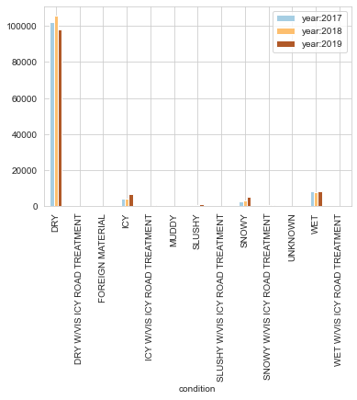
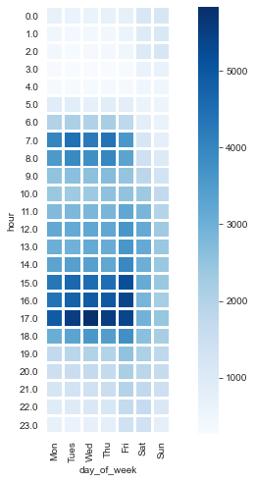
EDA: Crash API, Weather and Time
Group by weather (17-19)
Group by time and day of week
Key takeaways
In extreme weather, crashes can be concentrated. Snow and ice bringing slightly more crashes in 2019.
Meanwhile, crushes occur frequently during the morning and evening rush hours on weekdays
Notes:
Explain the number

Slide 28
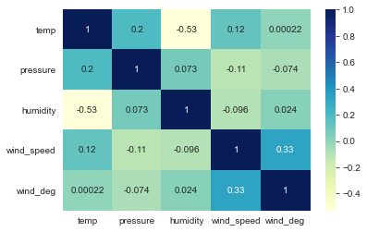
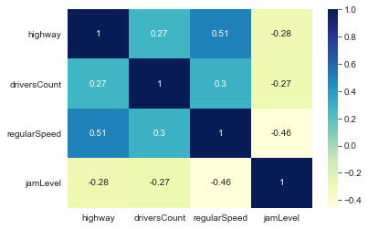
EDA: Features Correlation
Corr matrix for weather data
Corr matrix for cdot data
Key takeaways: Detect correlation between variables (highway & driving speed; wind speed & temperature, etc.). It is recommended to select only one of the relevant variables or to use a model that is not sensitive to correlation.

Slide 29
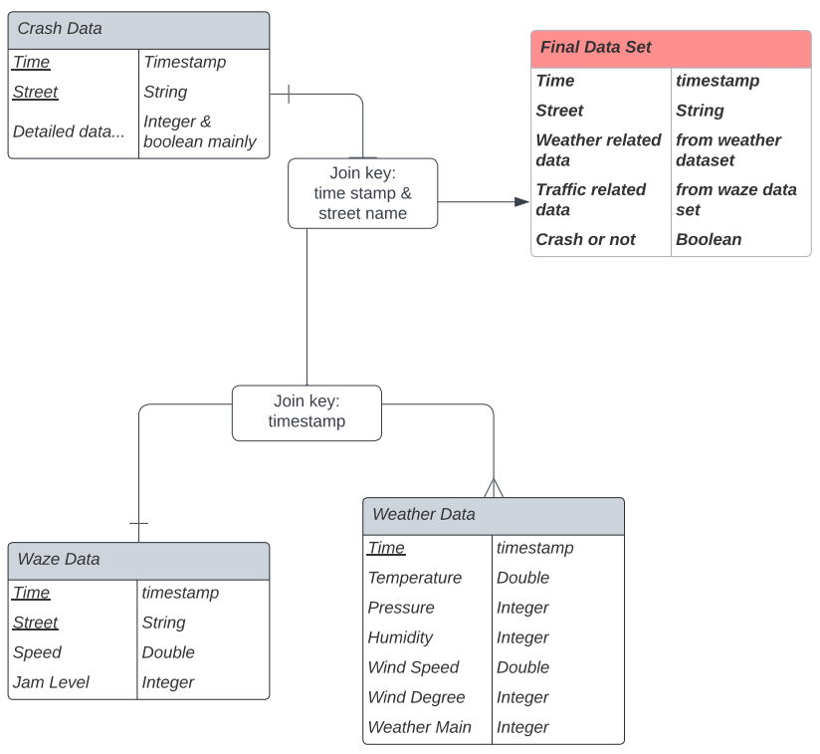
Creation of Final Data
Join by keys:
Time: timestamp round to hour
Location: Streets we focused
- unified them in the cleaning part
Generate new column:
Crash label, 0 means regular,
1 means crash happen
Notes:
Change the lucid chart

Slide 30
Model

Slide 31
Model
Midterm Recap
Reduced the max depth, yet -
f1-score : 0.98
Post Midterm Work
Added new roads to the dataset
Modification 1
Used Ensemble model - GBM
F1-score: Test - 64% Train - 99%
Probable class imbalance

Slide 32
Final Model
Using Weather data, crash labels from crash data, jam level from Waze and time features from timestamp.
Representation of crash data labelled 1 and 0:
{0.0: 42991, 1.0: 1620}
Crash scenarios barely have any representation
SMOTE to handle class imbalance
After SMOTE: {0.0: 42991, 1.0: 42991}
Decision Tree Algorithm - Max Depth = 8
Metrics - f1_score
Test: 86.48%
Train: 86.78%

Slide 33
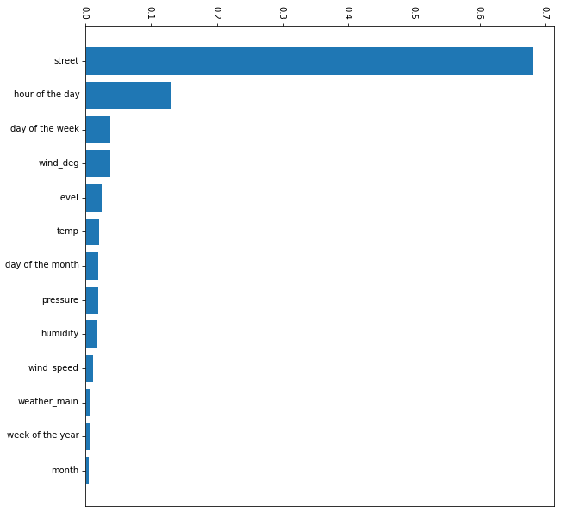
Model Analysis
Feature Importances
Street has the highest importance as expected
Hour of the day has the second highest importance
Followed by wind degree and day of the week

Slide 34
Final Deliverables

Slide 35

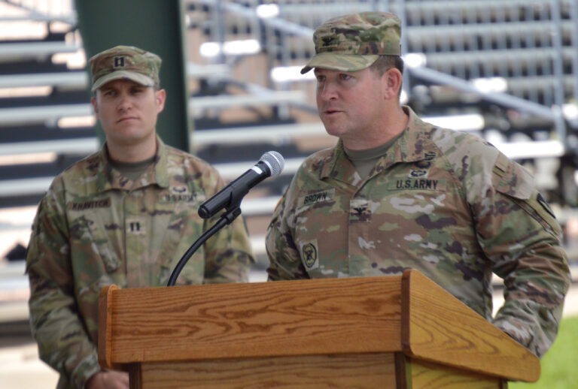
A Refresher
GARRISON SAFETY OFFICER
“As the Garrison Safety Officer, I want to know the likelihood of weather-related driving accidents tomorrow, so that I may plan to close/open the base accordingly.”
Col. Sean M. Brown, commander, U.S. Army Garrison Fort Carson
Notes:
Our main stakeholder is the GC. Remember, GC wants data-backed assistance to take an informed decision to shut or open the Fort gates.

Slide 36





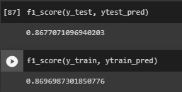
Making Sense of the Crash Probability
Trained Model
Forecasted Weather for each street
Source: https://www.freepik.com/premium-vector/highway-junction-top-view-road-intersection-with-turnings-circle-overpasses-aerial-view-city-traffic-lines-vector-cartoon-illustration_30962244.htm

Slide 37
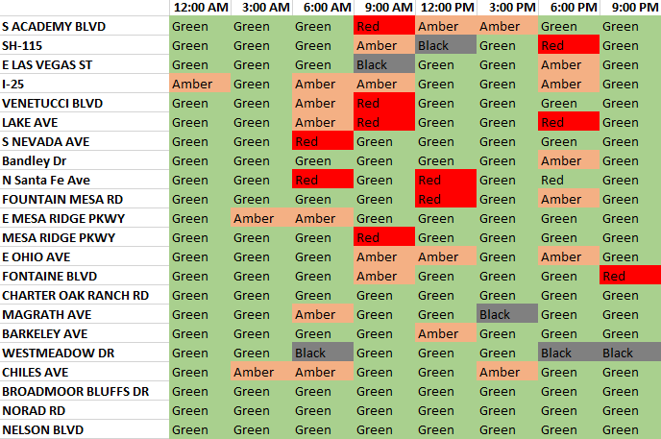
Making Sense of the Crash Probability
Street level BRAG Forecast

Slide 38
Delivering Value
Street level BRAG Score Prediction for next 24-72 Hours.
Dashboard for the Garrison Commander.
Real Time & dynamic prediction of weather and hourly BRAG forecast for each street.

Slide 39
Dashboard

Slide 40



Dashboard Tech Stack

Slide 41
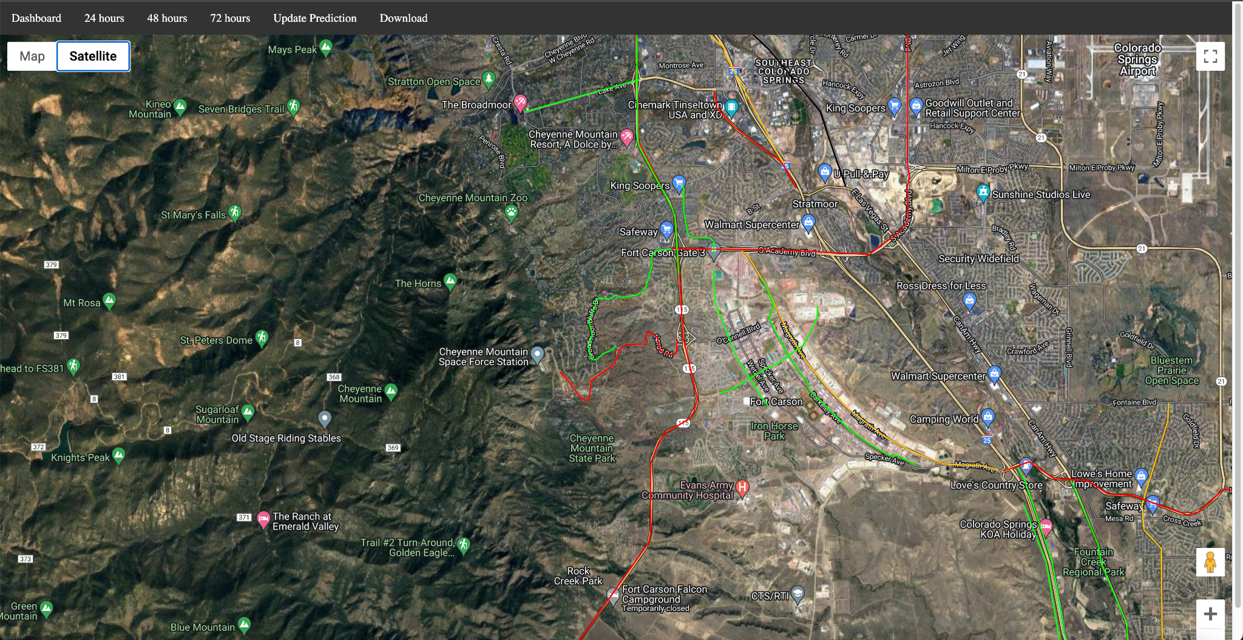
What does it do?
Web Platform
Safety Score Predictions for Selected Roads up to 72 Hours.
Direct Visuals on Map
CSV File of Specific Predicted Safety Scores for Roads in 3-hour Intervals.

Slide 42
Demo

Slide 43


Slide 44
Future Work

Slide 45
Future Work and Considerations
Additional Features
Scalability
UX
Road Grade
More Data
Snow Plow Schedule/Status
Interactive Dashboard
Other Cities
Vehicle Type
Notes:
Road grade = slope of roads
Snow plow schedule = would need data from city, policy work would be needed here
Vehicle type = more accurate reporting from police or insurance agencies needed
More data = more years of data. Considerations: do people drive differently in the next five years? Due to technology? Do we bother using 2020 data in 2030?
Other cities = how can this model be automatically used in another city?

Slide 46
Questions?

Slide 47
Overview (An, Ad, J, W, Y, S)
Introduction
Project Overview
Objective
Work Done So Far (Midterm) and Issues
Datasets —--- {Introduction, Waze, CDOT(y), Weather}
Approach Taken {EDA, Merging DataFrame}
Modeling
Results of the model
Safety Score to BRAG Value Conversion
Deliverable to Officer
Output {Dashboard}
Demo
Conclusion & Future Work

